Slide 1
Automate yourself out of a (backup) job
Joe Houghes
Sr. Infrastructure Engineer, FullStackGeek, Lazy Admin
(Not a Veeam Vanguard, but thanks Matt)

Slide 2
What can automation do for you?
Veeam can be fully automated to deploy, manage and report on all of your backup / backup copy / file copy / VM copy and replication jobs FOR FREE!! **
“Working with Veeam PowerShell cmdlets and scripts in many respects depends on your imagination, skills and expertise in Windows PowerShell.”
**(Caveats on some new features)
Notes:
Veeam installations themselves can also be automated, I’ll mention a PowerShell script for this later
Veeam encourages that you leverage using PowerShell scripts for managing your environment, there is a great support forum that exists to help you and is a wealth of knowledge
You can do *nearly* everything in code that you can in the GUI, currently no possibility for creating backup jobs against protection groups in PS Module for 9.5U3

Slide 3
Is backup automation for you?
Should your backups be manual or automated? How about the testing of your backups — manual or automated?
How are your backups being created currently? Is this sufficient for your needs?
How are your backups being tested currently? Is this sufficient for your needs?

Slide 4
Ask yourself – How do I maintain control?
How do you make changes to jobs?
How do you handle advanced job options?
How do you make changes to your backup infrastructure?
Notes:
This includes backup jobs, copy jobs, replication jobs, VMs being backed up, guest processing, schedules, job options - proxy, repository, retention
These include backup modes, compression/deduplication, backup corruption & file maintenance, notifications, VMware tools quiescence/CBT, storage integration, and job scripts
This is specific to servers, proxies, repositories, credentials, virtual/physical environments, storage arrays, and even maintenance of any components

Slide 5
Testing changes*
Now, how are you testing these changes to your environment?
How are you tracking changes to your configurations?
Do you need better control or standard "policy-style" settings to be applied?
Have this need? Automation can provide standardization and ensure more robust Availability for your organization.

Slide 6
Defining success of backups & Availability
Before starting with code, define a goal. Think about the task and desired result.
Are you turning to automation for the benefit of the business?
In this context, automation isn't solely about speed or performance.
Focus on standardization, validation and efficiencies gained with the enhanced productivity.
Notes:
This is the same whether you are using the GUI or CLI. Plan for success.
Try to be specific about steps/components, and have an expectation before you start.
Think availability, not impressing someone with your code. It’s not just about doing it fast, but doing it correctly and being certain that it stays that way.
The goal of these efforts isn’t just about getting your backups into code, it is the benefits that you can gain from it: standardization, granular control, validation of configs, and testing for success
It’s not just about the code.

Slide 7
Veeam & PowerShell basics

Slide 8
PowerShell basics for starting out
Never be afraid to ask for help. Get-Help is not just your friend, it's intended to make your life easier.
PowerShell is built for pipeline, embrace it and leverage it.
Stack your cmdlets and results like Lego. Buy yourself a set if you're outdated on this concept. (Check out Lego Voltron)
Forget what your teachers told you: Cheat and / or look up the answer whenever possible.
Notes:
Other people are also normally glad to save you some pain in your journey.
First, get an object, then work with it.
Seriously, get some Legos to practice. The new sets can be a complex final product with many distinct steps to get you to your final product. This is why you should have specific steps and an expected result at the start.
Believe it or not, you can even cheat from yourself. If you are trying to learn the code or find a specific setting, create or change it in the GUI and then pull it up in PowerShell to find how it was done.
You can teach this to yourself if you just put in the effort, and you can always ask for help if you get stuck.
Focus on the result, it is only important that you attain the goal or desired result
The path to get there doesn’t matter to the business as long as you achieve success.

Slide 9
Veeam-specific PowerShell tips*
Search Veeam cmdlets specific to your version: Get-VBRCommand [-V95] [-V90] [-V80]
What is your type? What are your members?
Now that you know your type, where can it be used? Get-Command -ParameterType *TypeName*
A little bit of validation… Understand the allowed values of parameters: Look up the Veeam PowerShell enumerations
Notes:
I've seen a lot of people miss this cmdlet. Launch from GUI drop down menu or using the 'Initialize-VeeamToolkit.ps1' script
I’m not asking about your preference in dating or a significant other, but what type of object are you working with and what properties does it have? Remember, this is an object oriented language. Spoilers: You can even cheat and find the types of Veeam objects with looking at their formatting file

Slide 10
Starting at the beginning
Step 1: Start-VBRConfigurationBackupJob
Step 2: What are you trying to accomplish? Think MVP.
Step 3: Add-PSSnapIn VeeamPSSnapIn
Notes:
If you haven’t set up your configuration backup job, do so now.
Always be sure to back up your configuration before making modifications, especially when they are scripted.
Define a “minimum viable product” and build on it. Remember that you plan for success and defined a specific goal and the steps to get there. This allows for your code to be modular, and you should be prepared for a journey.
Don’t expect to immediately automate your environment or that you will have accounted for all of the necessary components to be flexible.
It’s finally time to get started

Slide 11
Let’s see some code

Slide 12
Basic infrastructure deployment
You can fully deploy Veeam infrastructure by adding Windows and Linux servers, proxies, repositories (including SOBR) and credentials, plus virtual hosts / clusters / entities — all from a fresh Veeam install without opening the console.
Steps for a VERY basic Veeam deployment post-installation:
(Assumes Veeam Backup & Replication admin role, shared proxy / repository Windows server, 'D:\Backups' as repository folder)
Notes:
This is just a quick walkthrough to show that with a few lines of code and basic input, you can configure :
Credentials used to configure Veeam servers/proxies/repositories
Connection to your virtual environment
Managed servers used by Veeam (this is the basis for a proxy)
Defining the proxy role for managed server
Repositories to be used with your Veeam jobs

Slide 13
Basic deployment – User input
$VeeamVBRServerName = Read-Host -Prompt "Veeam B&R Server Name"
$VeeamProxyServerName = Read-Host -Prompt "Veeam Proxy Name"
$VeeamVirtualServerName = Read-Host -Prompt "vCenter Server or ESXi Host Name"
$VeeamProxyCreds = Get-Credential -Message "Veeam Proxy Credentials"
$VeeamvCenterCreds = Get-Credential -Message "Veeam vCenter Credentials"

Slide 14
Basic deployment – Connect / creds
#Veeam VBR Setup:
Add-PSSnapIn -Name VeeamPSSnapIn
Connect-VBRServer -Server $VeeamVBRServerName
$VBRProxyCred = Add-VBRCredentials -Credential $VeeamProxyCreds -Description "Veeam Proxy Credentials"
$VBRVirtualCred = Add-VBRCredentials -Credential $VeeamvCenterCreds -Description "Veeam vCenter Credentials"

Slide 15
Basic deployment – Servers
#Veeam Managed Server Setup:
$VeeamVirtualServer = Add-VBRvCenter -Name $VeeamVirtualServerName -Description "vCenter Server" -Credentials $VBRVirtualCred
$VeeamWinServer = Add-VBRWinServer -Name $VeeamProxyServerName -Description "Veeam Proxy #1" -Credentials $VBRProxyCred

Slide 16
Basic deployment – Big finish
#Veeam Proxy & Repository Setup
$VeeamProxy = Add-VBRViProxy -Server $VeeamWinServer -Description "Veeam Proxy #1”
$VeeamRepository = Add-VBRBackupRepository -Name $($VeeamProxyServerName + "_Repository") -Description "Veeam Repository #1" -Server $VeeamWinServer -Folder "D:\Backups" -Type WinLocal
True, this is a VERY basic Veeam infrastructure relying on some default parameters.
Notes:
It is just a quick and easy to read walkthrough which will shows that configuration of the required credentials, vCenter connection, server/proxy/repository installation can be performed quickly and easily
I have used a similar setup to give to others who are new to Veeam and need ramping up on the platform to be effective within my/their organization, or as a quick lab deployment for testing
This will let you quickly produce a simple Veeam lab or demo environment, and is a decent base for testing your code against. It’s not always a good idea to be doing it live until you build some basics and confidence
And even for a very basic setup, come on, you have to admit that 8 lines of code to get it running isn’t bad at all. Just think of all the clicking you have saved yourself. Get to ‘Finish’ with no ‘next’ required.

Slide 17
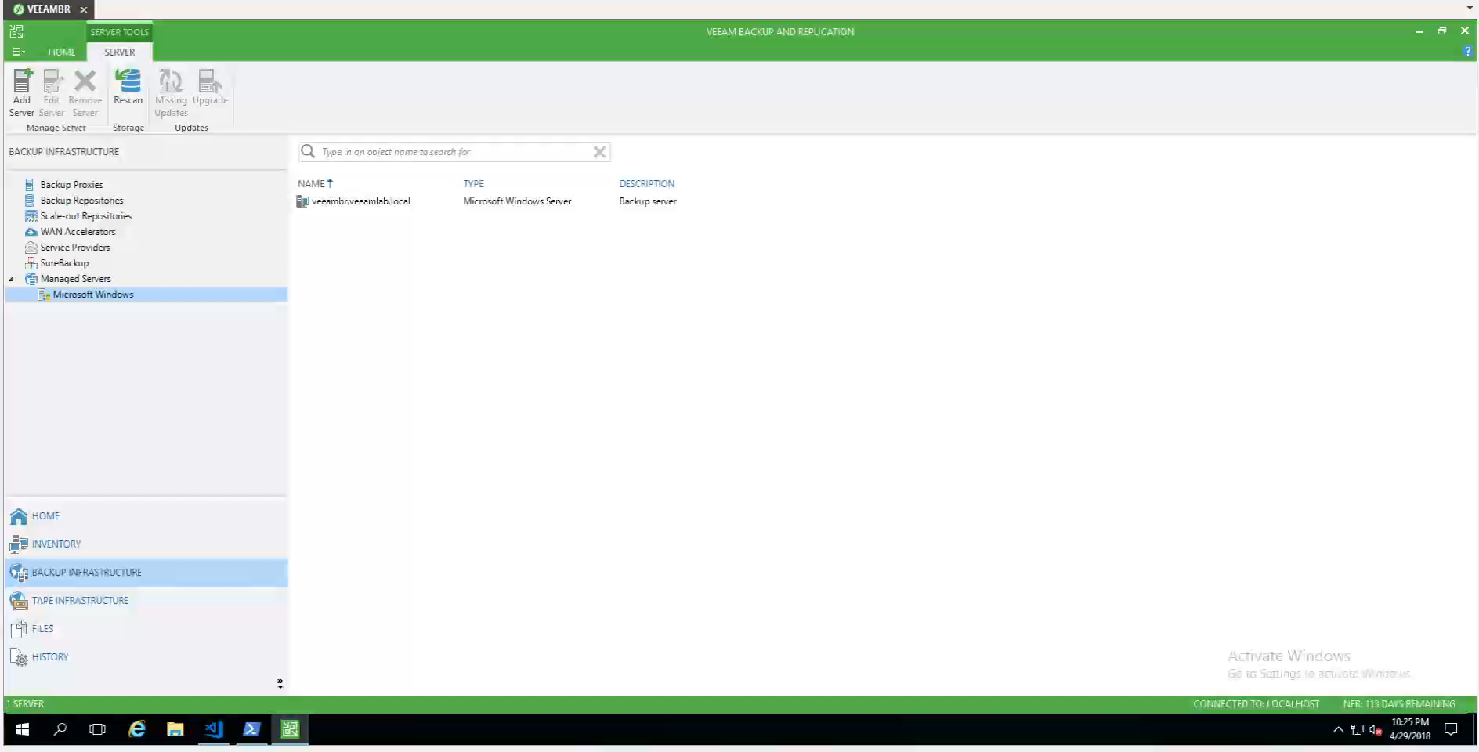

Slide 18
OK, so now what?
Now that Veeam is configured, you need a job to perform actual backup functions.
Creating jobs targeting objects are just as easy:
Hosts / clusters / VMs / templates / datastores / res. pools / tags (VMware)
Hosts / VMs / volumes (Hyper-V)
Pro tip: Leverage vSphere Tagging to drive selection for items to be automatically picked up into existing jobs and schedules — make your backups / backup copies run as a subscription model!

Slide 19
Automated job creation
Create a simple Veeam job to target a VMware Tag:
#Veeam User Input for VMware Tag
$VMwareTag = Read-Host -Prompt "VMware tag to be targeted for backup job"
#Veeam Backup Job Setup
$VeeamTag = Find-VBRViEntity -Name $VMwareTag -Tags -Server $VeeamVirtualServer
$VeeamBackupJob = Add-VBRViBackupJob -Name 'Demo Backup Job' -Description 'Demo backup job created via script' -BackupRepository $VeeamRepository -Entity $VeeamTag

Slide 20
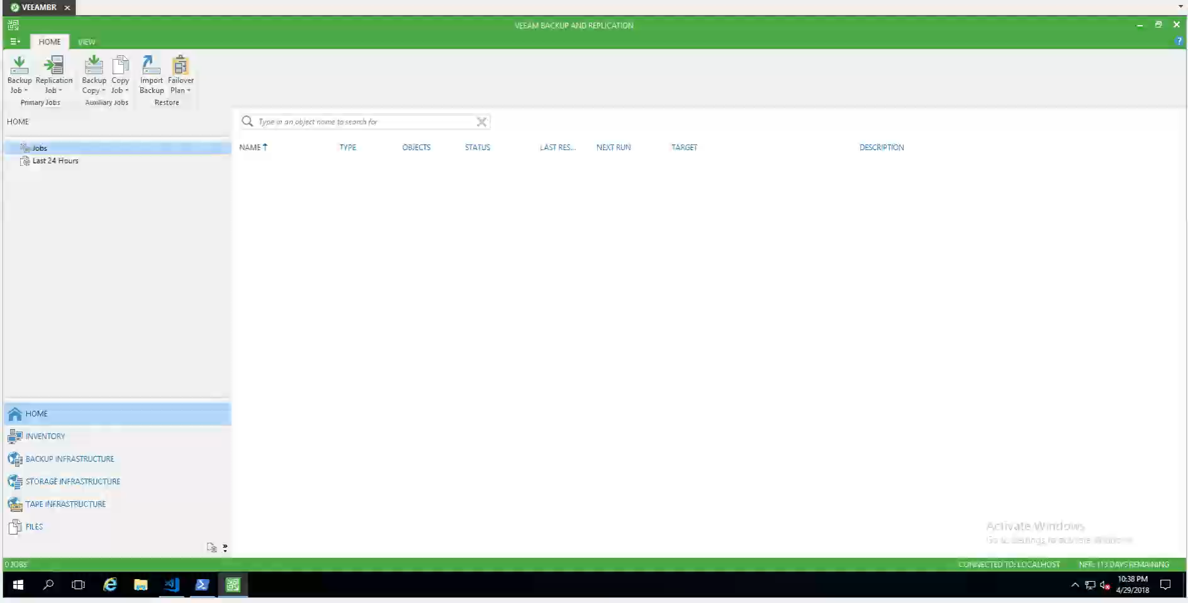

Slide 21
I don't want to run that manually
Simple job scheduling examples:
Set-VBRJobSchedule -Job $VeeamBackupJob -Daily -At "20:00" -DailyKind Everyday
Set-VBRJobSchedule -Job $VeeamBackupJob -Monthly -At "21:00" -NumberInMonth Last -Days Friday
Set-VBRJobSchedule -Job $VeeamBackupJob -Periodically -FullPeriod 4 -PeriodicallyKind Hours
Notes:
Me either, unless I am performing a test run of a newly created Veeam job.
Job scheduling can become a bit tricky if you are using a more custom schedule than some daily, weekly or some specific number of hours for each job run.

Slide 22
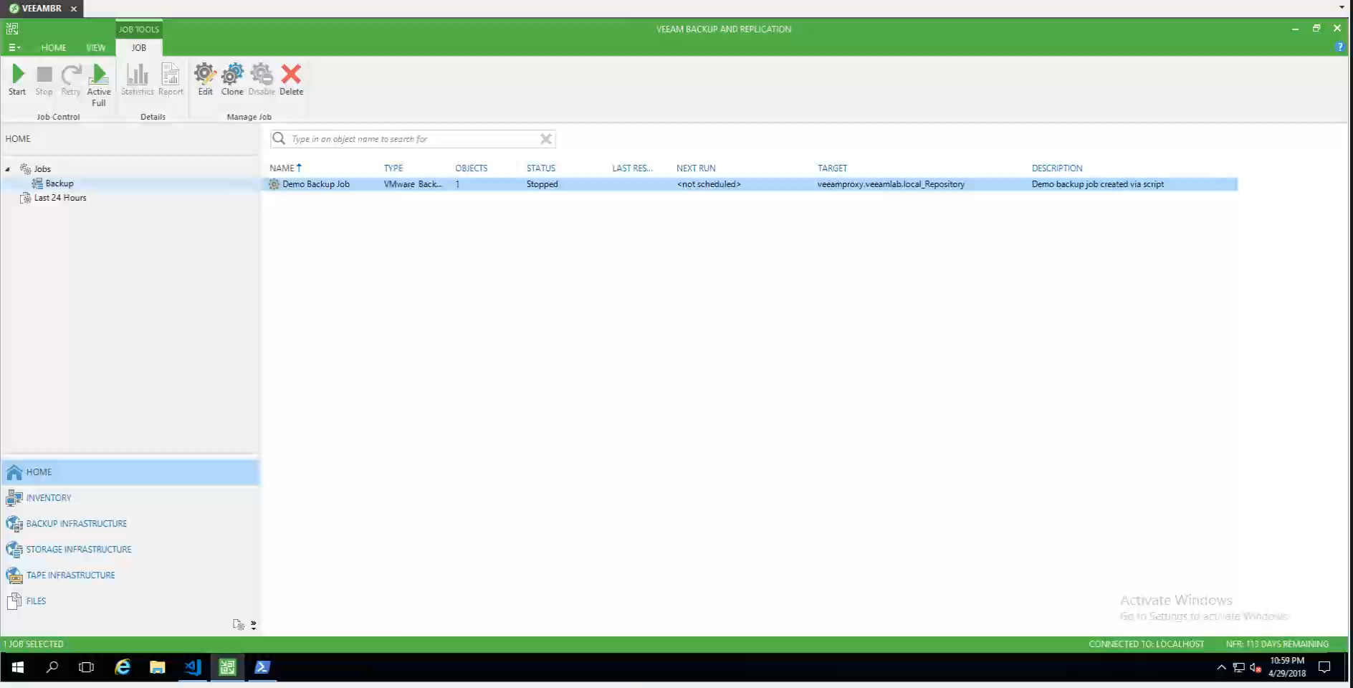

Slide 23

Veeam Tech Support can help!
Matt Fonner
from Veeam Support
Notes:
“What not to do”
“What kinds of issues can people have when doing restores”
“What

Slide 24
What to expect
1
2
3
How does Veeam support automation and scripting with PowerShell?
What are good resources to test and learn about Veeam PowerShell?
What are some areas to check if a script is not working?
Notes:
“What not to do”
“What kinds of issues can people have when doing restores”

Slide 25
What options do I have?

Slide 26
You’ve always got options
$VeeamBackupJobOptions = New-VBRJobOptions –ForBackupJob
$VeeamBackupJobOptions | Get-Member -MemberType Property | Sort-Object Name
$VeeamBackupJobOptions includes the following properties:
Options: This top-level property contains a root node, which will display all job options.
At a quick view, this property gives: manual / scheduled runs, backup chain mode, compression / deduplication, email notifications, retention, SAN snapshots / failback, VM deletion, VMware tools quiescence / CBT, etc.).
Notes:
This is where Veeam has done some of the heavy lifting for you.

Slide 27
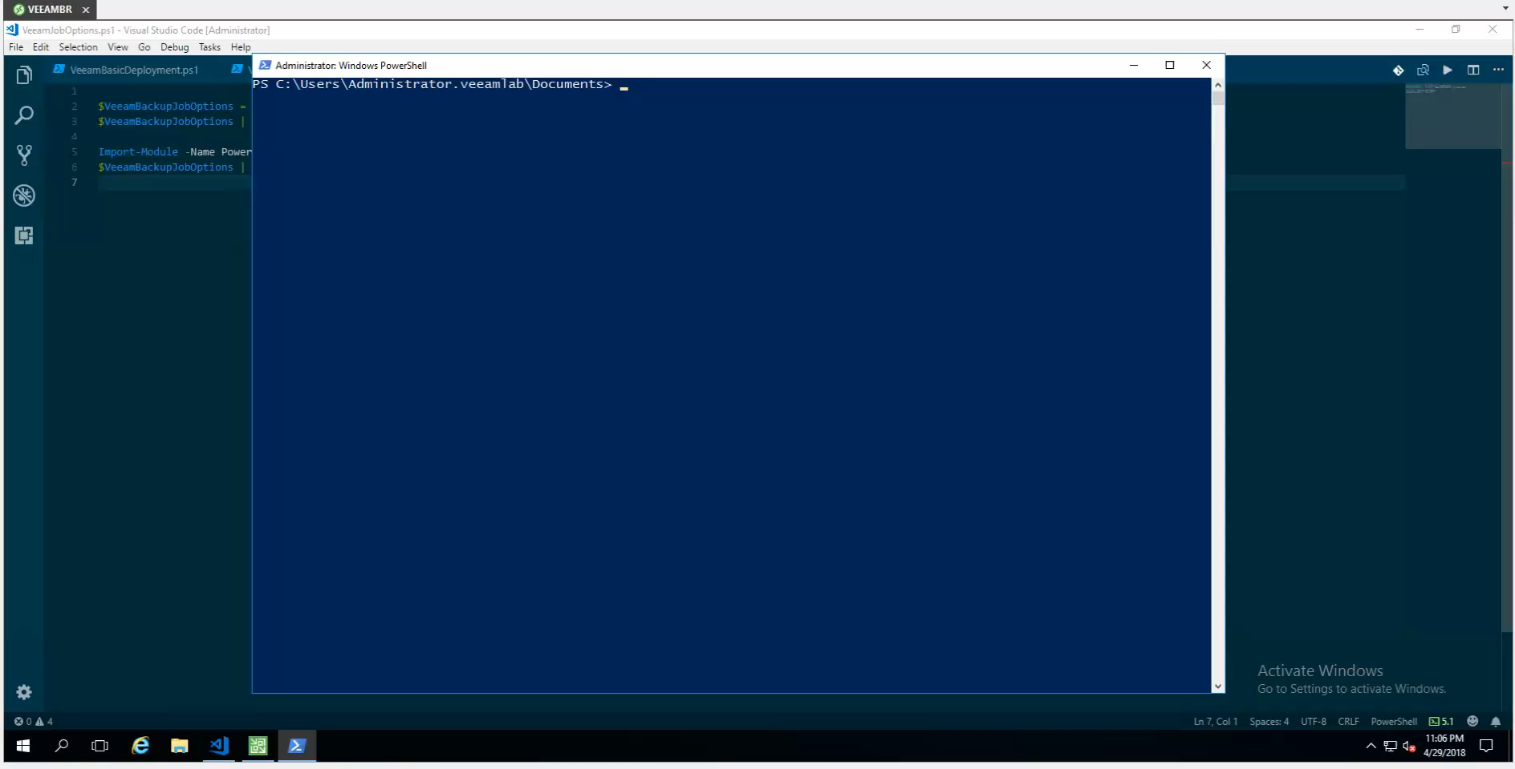

Slide 28
Backup job options
The other job options and a few samples of the most important properties contained within are:
BackupStorageOptions: Number of restore points, retention period for deleted VMs, compression / deduplication, enabling and scheduling of integrity checks, backup encryption
BackupTargetOptions: Backup chain mode, active full enabling and scheduling, synthetic full enabling and scheduling
FailoverPlanOptions: Scripts for pre- and post-failover plan enabled / disabled, script paths
JobOptions: Automatic proxy selection, manual / scheduled runs, WAN accelerator enabling, backup window / termination, backup throttling

Slide 29
Backup job options continued
JobScriptCommand: Scripts for pre- and post-job enabled / disabled, script paths, frequency to run scripts
NotificationOptions: SNMP notification enabling / disabling, email notification enabling / disabling, email settings for success / warning / error, suppress email until last retry, VM attribute to update upon success
SanIntegrationOptions: SAN snapshots enabling / disabling, VMs to back up per SAN snapshot, failback to VM snapshot, Hewlett Packard Enterprise / Nimble-specific SAN integration settings
SqlLogBackupOptions: SQL transaction backups enabling / disabling, log backup interval, log retention interval
ViSourceOptions: Encrypt LAN traffic, failover to NBD, CBT enabling / disabling, VMware tools quiescence enabling / disabling, VM template backup enabling / disabling, exclusion of swapfile / dirty blocks

Slide 30
Other options to be aware of
GenerationPolicy: (Backup copy jobs settings) Enabling and retention period for deleted VMs, backup copy interval (RPO definition), sync interval start time, GFS retention settings
EpPolicyOptions: (Backup agent settings) Authentication mode, agent / server controlled, backup system state / user folders / specific paths, include file system items, include / exclude masks, retention, backup target
CloudReplicaTargetOptions: Veeam Cloud Connect host and storage
ViCloudReplicaTargetOptions: Veeam Cloud Connect replica enabling / disabling, Veeam Cloud Connect replica host and storage

Slide 31
Replica & Hyper-V options
ReplicaSourceOptions: Option to replicate from backups
ReIPRulesOptions: Rules for re-IP of replica VMs
ViReplicaTargetOptions: (VMware) Replica name suffix / prefixes, replica target folder / resource pool / datastore, re-IP enabling / disabling, VM seeding options
ViNetworkMappingOptions: VMware replica job network mappings
HvSourceOptions: CBT enabled / disabled, Hyper-V quiescence, crash consistency, off-host backup, exclude swap files / dirty blocks
HvReplicaTargetOptions: (Hyper-V replicas) Seeding settings, target folder, re-IP on replica, use network mapping options, VM mapping options
HvNetworkMappingOptions: Networking mappings for Hyper-V host

Slide 32
Moving past the basics

Slide 33
Setting advanced options
Method 1 – Native Veeam cmdlets:
Set-VBRJobAdvancedOptions
Set-VBRJobAdvancedBackupOptions
Set-VBRJobAdvancedStorageOptions
Set-VBRJobAdvancedViOptions
Set-VBRJobAdvancedNotificationOptions
Method 2 – No parameter for Set-VBRJobAdvanced* cmdlet…
Time to kick it old school!
Notes:
How do I set all of these job options?

Slide 34
Set options – Direct property update
Some options cannot be set with parameters or built-in cmdlets, but Veeam still gives you a way to work.
Other options are noted as not possible to be enabled with Veeam PowerShell, but they’re still job options:
$JobOptions = $VeeamBackupJob | Get-VBRJobOptions
$JobOptions.SanIntegrationOptions.UseSanSnapshots = $false $JobOptions.BackupStorageOptions.RetainDays = '14' $JobOptions.BackupStorageOptions.EnableDeletedVmDataRetention = $true
Set-VBRJobOptions -Job $VeeamBackupJob -Options $JobOptions
Notes:
Think of this the same as setting your defaults within the GUI, and hopefully you knew this was an option in the job wizard.
One of the #1 asked about job options to be configured is SAN Snapshots
Another example is the retention policy for deleted VMs

Slide 35
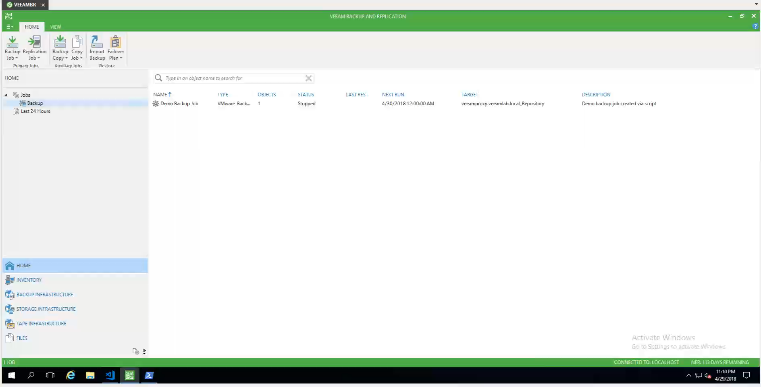
Notes:
Think of this the same as setting your defaults within the GUI, and hopefully you knew this was an option in the job wizard.
One of the #1 asked about job options to be configured is SAN Snapshots
Another example is the retention policy for deleted VMs

Slide 36
Cue the Clarkson – POWER!!!
When you use your imagination, as prompted in the “Understanding Veeam Cmdlets” page, you can perform some widescale advanced configuration
This makes proxy / repository maintenance easier for your other scripting and tooling
Perform functions that are feature requests — backup proxy groups:
$VeeamProxy1 = Get-VBRViProxy -Name 'proxy1'
$VeeamProxy2 = Get-VBRViProxy -Name 'proxy2'
$VeeamBackupJob | Set-VBRJobProxy -Proxy $VeeamProxy1, $VeeamProxy2
Notes:
We use this for updating job schedules around time zones (DST) and maintenance windows, since we have 2 B&R servers covering US and UK/APAC
Simple PowerShell scripts can align your backup, virtual, and physical infrastructures as you make changes – I use this to drive new backup jobs
Proxy affinity covers proxy -> repository mapping, but this allows flexibility.)

Slide 37
Let’s not forget the physicals/clusters
Veeam Agents and protection groups can also be controlled in code*
(*Protection group jobs not possible with PowerShell yet)
$VeeamDomain = Get-VBRADDomain -ServerName 'dc2.veeamlab.local' -Credentials $VBRProxyCred
$VeeamDomainComputer = Find-VBRADEntity -Domain $VeeamDomain -Name 'dc.veeamlab.local’ -Recurse
$VeeamADScope = New-VBRADContainer -Domain $VeeamDomain -Entity $VeeamDomainComputer -MasterCredentials $VBRProxyCred -ExcludeVMs:$false -ExcludeComputers:$false
$VeeamProtectionGroup = Add-VBRProtectionGroup -Name "AD Backup" -Description "Physical Server Agent" -Container $VeeamADScope
Enable-VBRProtectionGroup -ProtectionGroup $VeeamProtectionGroup

Slide 38
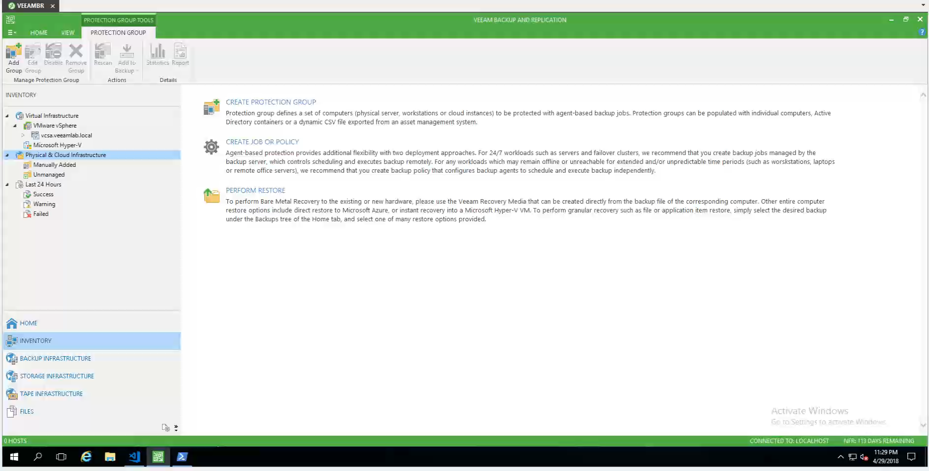

Slide 39
Takeaways
PowerShell types: https://helpcenter.veeam.com/docs/backup/powershell/veeam_powershell_types.html?ver=95
PowerShell enumerations:
https://helpcenter.veeam.com/docs/backup/powershell/enums.html?ver=95
Veeam unattended install:
https://github.com/VeeamHub/powershell/tree/master/BR-UnattendedInstall
Digging into PowerShell parameters:
https://richardspowershellblog.wordpress.com/2018/03/05/cmdlet-parameters/
Handy PowerShell scripts:
https://www.powershellgallery.com/packages/PowerShellCookbook/1.3.6

Slide 40
Thank you

Slide 41
Session Survey Available Now!
Please take the very short (5 question) survey through your mobile app now!
1
Tap on the session
2
Scroll down past Presenters
3
Tap Session Feedback Survey

